Slide 1
DEPARTMENT OF AUTOMOBILE ENGINEERING
KEC
Development of N-Share App for Mobile Data Transfer
& Sharing

Slide 2
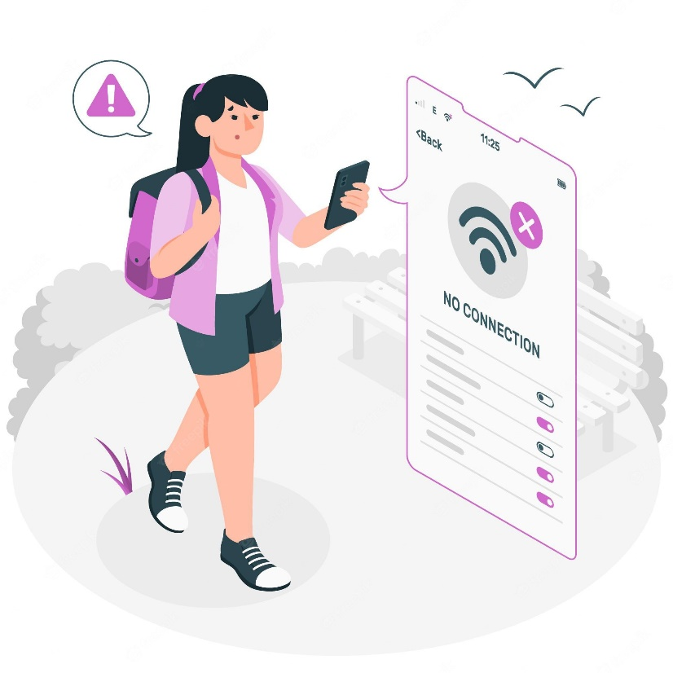

The Problem
In our modern world most of the people using internet. Depending on the signal of the phone, data(GB/MB) is reducing rapidly.
Today’s world they can transfer money, but they cannot transfer data to one person to another person.

Slide 3

The Problem
Most people do not consume their entire internet data(GB/MB) in a day.
By using a hotspot connection only, we can share our data(GB/MB) for nearly available persons.
Because of this issue lots of daily internet data(GB/MB) were not used by most of the people.
Without hotspot, they can’t transfer their Internet data to his/her families and friends.
871.21 MB
remaining of 2GB
renews in 25 mins
Check usage

Slide 4

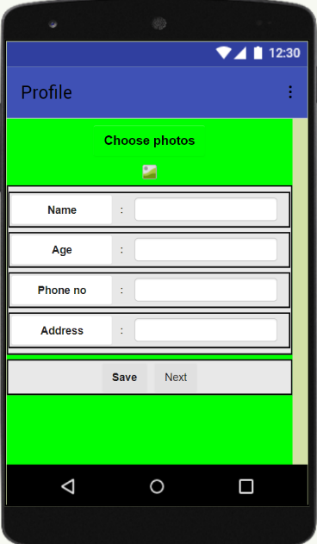
The Solution
Suppose people have an option to share their non used extra Internet data(GB/MB). This app gives an easy way to transfer their Internet data(GB/MB).
The uniqueness of this APP is, we can transfer our Internet data(GB/MB) even if the people whom we like to send is far away from their place
User 1
User 2
User 1
User 2
900 MB
0 MB
800 MB
100 MB

Slide 5
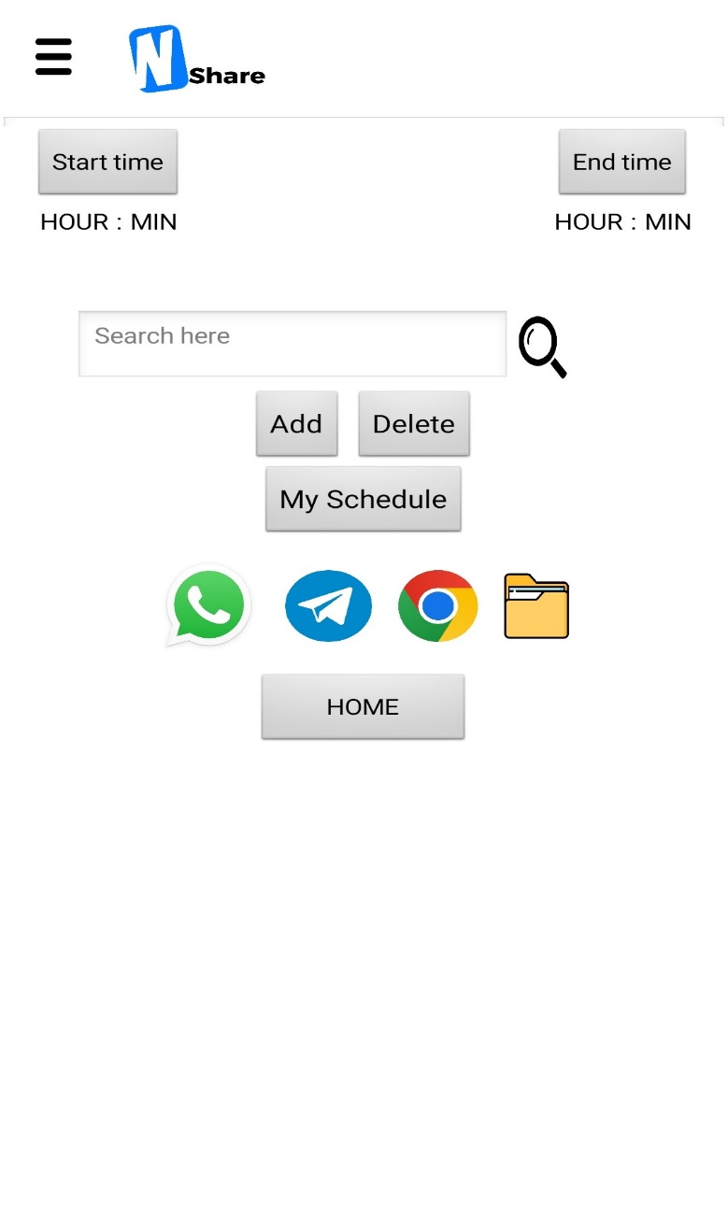
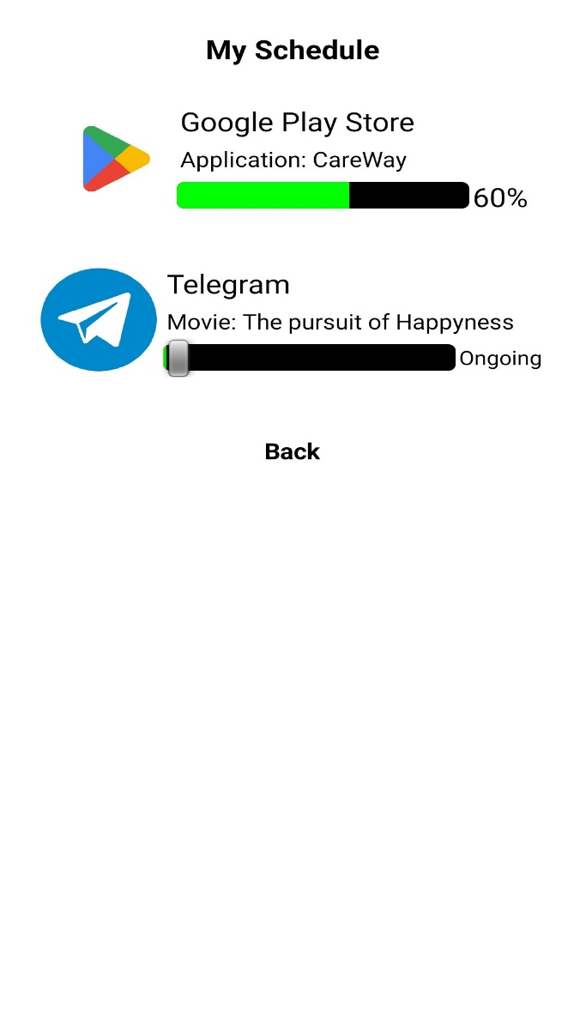
Scheduler
We can able to use our excess daily mobile data for different kind of downloading, updating, and so on.
This page shows what are the apps using scheduler for downloading or updating

Slide 6
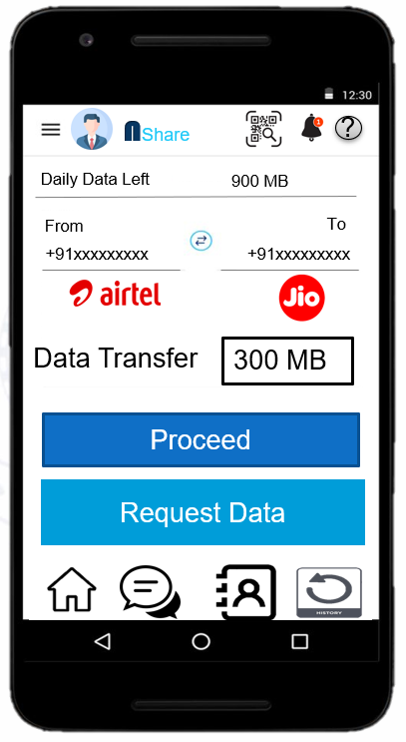
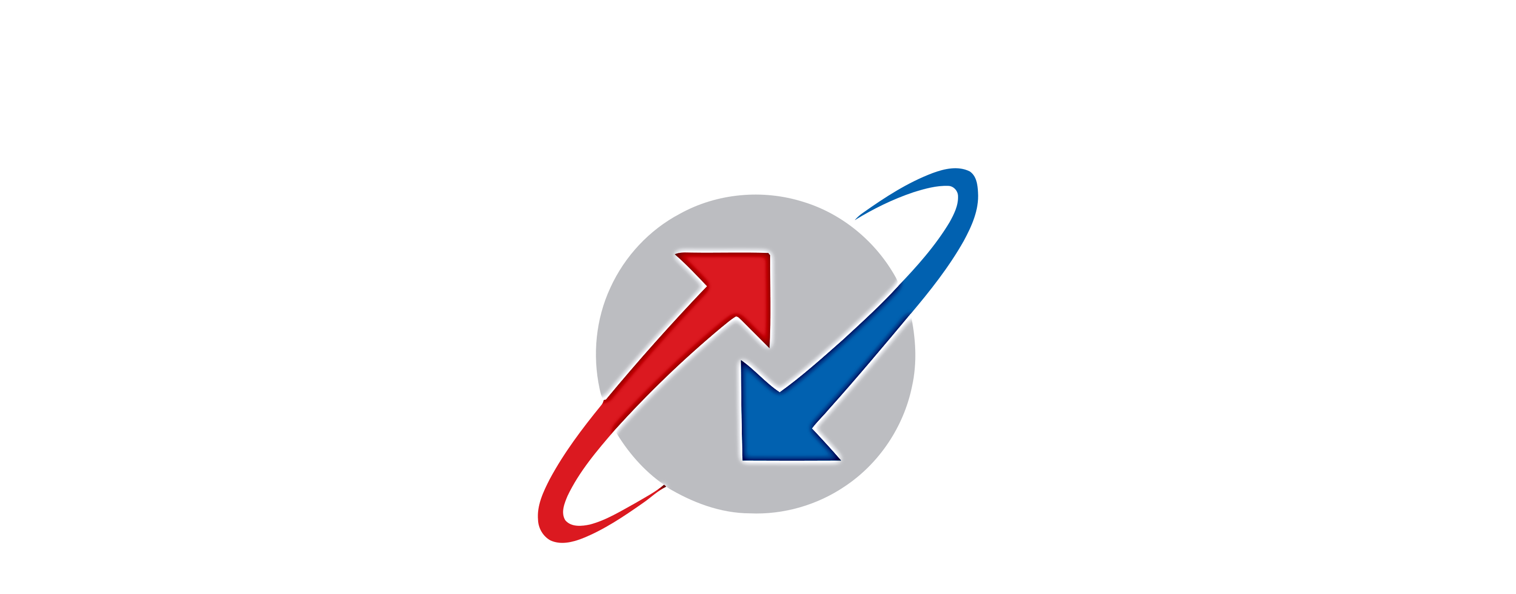
Flowchart / Product workflow
Analysis & Planning
UI/UX Design
Implement in Android Studio
Build apk
Navigation Feature
Development support

Slide 7
Uniqueness / IP & Value Proposition
Explain the uniqueness and distinctive features of the (service) solution
Like money transfer, our APP offers the facility to transfer Internet Data from one number to another number.
Why should customers choose you? What is your value proposition? What benefit do you give to your customer?
You can transfer data instantly from one mobile to another using the data transferring system in our app.
We provide many options to share the MB between the same and different networks, such as Airtel to Airtel, Airtel to Jio, Jio to Idea etc.…
Is your product “nice to have (want)” or “must to have (need)” ?
Most people do not consume their entire network in a day. Suppose they have an option to share their non used Internet Data(GB/MB).This app gives an easy way to transfer their Internet Data(GB/MB).

Slide 8
Technology Readiness Level
Our technology readiness level is: TRL 3
This is our idea to create an application for transferring network data(GB/MB).
In this stage, we just create an idea to what are the features are available and analysing the stages of the application
Privacy policy: https://pages.flycricket.io/nshare/privacy.html
Terms & condition: https://pages.flycricket.io/nshare/terms.html

Slide 9
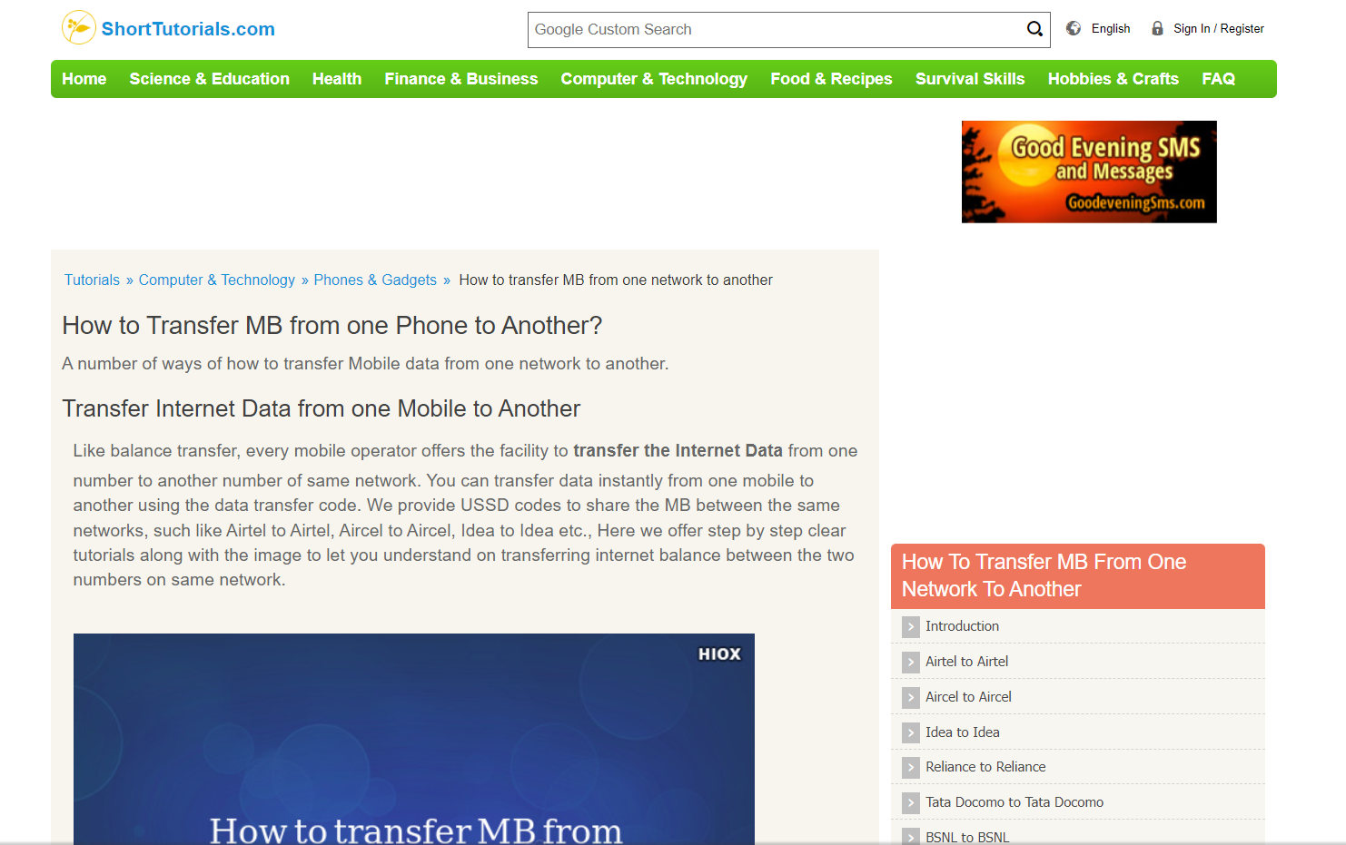
Reference

Slide 10
Thank You !!

